Slide 1
Military Casualties 2001 - 2012
Chris Cottitta
Xan Christopherson
Pheng Tang

Slide 2
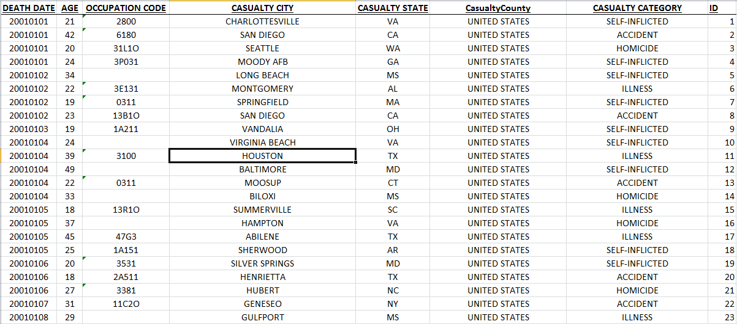
The Data (18k+ rows)
Original Source: http://catalog.data.gov/dataset/us-active-duty-military-deaths-since-1-jan-2001/resource/572f48b3-d316-4349-ab53-59dbeef7eb24
Our modified version: https://docs.google.com/file/d/0B6VNqDl7tGDtdk5JSkJuSTdzLTA/edit

Slide 3
Data Struggles
Date
– originally read as integers, they now read as actual dates
Occupation Codes
Country codes
- US, USA, North America (redundancies)
Null values

Slide 4
Hypotheses
Deaths will increase in years of direct-open war
The number of self-inflicted deaths will increase in correlation with killed-in-action and other wartime related deaths

Slide 5
Missing Picture
B lank/Null Fields
Field Count (18127) Percentage
Age 2 00.01%
Casualty Category 3 00.02%
Casualty Country 80 00.44%
Occupation Code 2482 13.69%
Undetermined/Pending Casualty Category
Undetermined 281 1.55%
Pending 249 1.37%
Casualty City
Classified 2 00.01%

Slide 6
Additional Analysis
No “PTSD” Casualty Category
Research still ongoing to identify PTSD
Not conclusive
PTSD
“the risk of death from suicide among middle-aged and older US males is independent of veteran status and suggest that policies to prevent veteran suicide should focus on factors that may heighten suicide risk rather than on veteran status per se.”
"Almost half of the suicides we're experiencing are from soldiers who haven't even deployed," Carpenter said. "There's more to this than just the mobilization and deployment piece."

Slide 7
Works Cited
Army guard battles soldier suicides. (2010). (). Lanham, United States, Lanham: Federal Information & News Dispatch, Inc. Retrieved from http://search.proquest.com/docview/190346583?accountid=10559
Matthew Miller, Catherine Barber, Deborah Azrael, Eugenia E. Calle, Elizabeth Lawler, and Kenneth J. Mukamal . Suicide Among US Veterans: A Prospective Study of 500,000 Middle-aged and Elderly Men. Am. J. Epidemiol. 2009 170: 494-500.

